Slide 1

BCA (DATA SCIENCE) VI SEM GROUP PROJECT
DISASTER DETECTION SYSTEM
TEAM MEMBERS:
KARRI SUSANNA
Regd.no: 2021-2222021
P. CH. SRIVATHSA SARMA
Regd.no: 2021-2222028
KANDIPILLI TEJUS
Regd.no: 2021-2222033
ADIGARLA SARATH KUMAR
Regd.no: 2021-2222034
PAMPANA JAIKIRAN
Regd.no: 2021-2222043
Under Guidance of
Smt. U. Sahiti
Assistant Professor
Department of Computer Applications (UG)

Slide 2
Contents
1
4
ABSTRACT
UML DIAGRAMS
2
FUNCTIONAL REQUIREMENTS
5
CONCLUSION
3
NON-FUNCTIONAL
REQUIREMENTS

Slide 3
Abstract
The "Disaster Detection System" incorporates a crucial image processing process that utilizes advanced machine learning techniques to categorize images, identifying various types of disasters. This component stands at the forefront of disaster monitoring and response efforts. By improving accuracy and responsiveness in identifying disasters, it aims to provide authorities and organizations with more accurate information.

Slide 4
Help
Click on 'Abstract' to see the project Abstract.
Click on 'Help' to get helpful information.
Click on 'Start' to Run the program.
Click on 'Home' button to go back to Home screen.
Click on the 'Load Model' to Select the CNN model and Load.
Click on the 'select Image' to select to upload an image.
Check the image information and make sure the image meets the minimum resolution of 150*150.
Click on 'Process images' button to process the image.
After processing the image check for the prediction.

Slide 5

Functional Requirements:
Image Input:
Accept images in various formats (JPEG, PNG, etc.).
Support file upload for uploading images.
Allowing compatible images above the minimum resolution of 400*400.
Allowing compatible images upto a maximum of 4K resolution.
Preprocessing:
Preprocess images for normalization and resizing.
Feature Extraction:
Extract relevant features using techniques like CNN.
Classification:
Enable real-time classification for classifying new images.

Slide 6
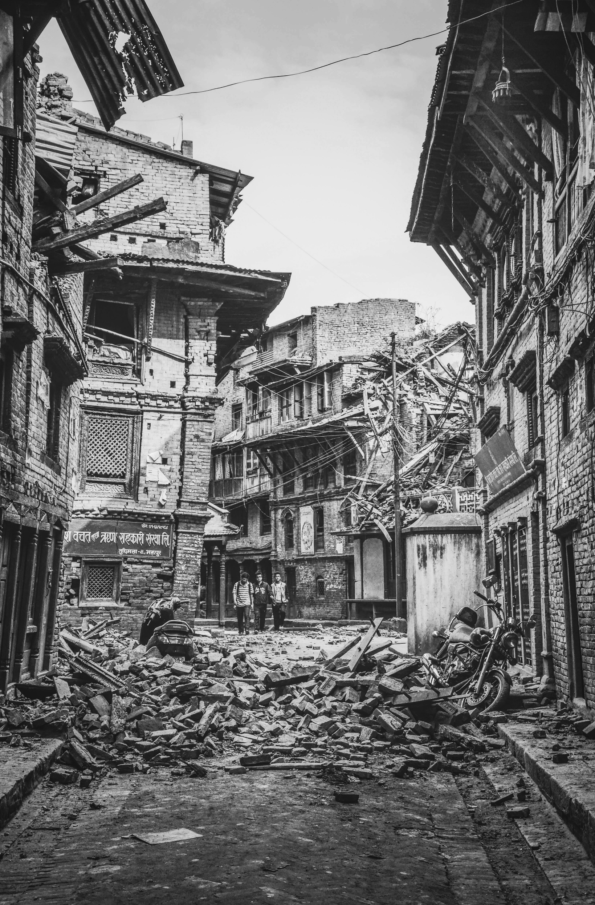
Non-Functional Requirements:
Performance:
Fast and efficient image processing.
Low-latency inference for timely classification.
High accuracy in classifying diverse images.
Efficient utilization of computational resources.
Robustness:
Ensure reliability and effectiveness
Enhance overall longevity of the system.
Usability:
Intuitive user interface for ease of operation.

Slide 7

System Requirements
Minimum H/W Specifications:
Processor: A Dual-core processor
RAM: 4 GB RAM
Hard Disk: 128 GB HDD or SSD

Slide 8
S/W Specifications:
Operating System: Windows 10 or above
Server-side Script: Python
IDE: Visual Studio Code (VS Code)
Libraries Used: Pandas, Scikit-learn and Keras
Model Persistence: Pickle.
GUI Development: Tkinter
Machine Learning Frameworks: CNN

Slide 9
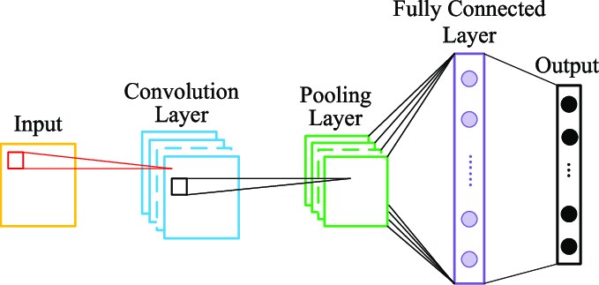
General Structure of Convolutional Neural Network

Slide 10
UNIFIED MODELLING LANGUAGE (UML) DIAGRAMS

Slide 11
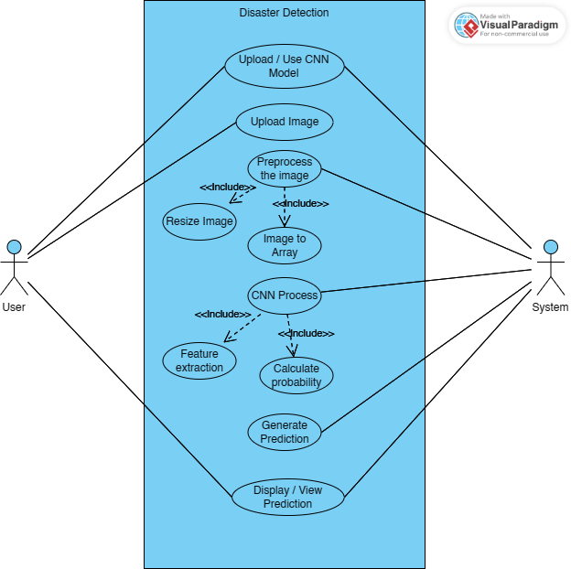
Use Case Diagram

Slide 12
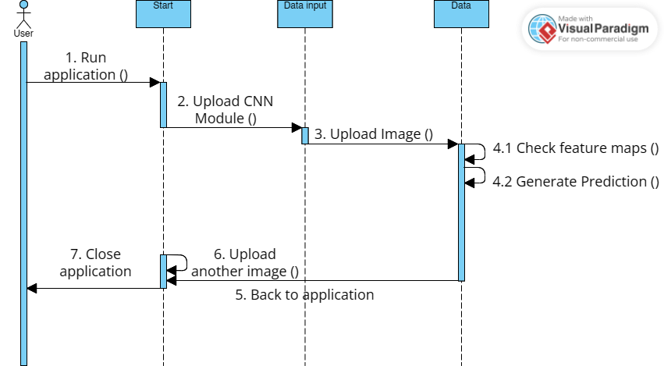
Sequence Diagram - User
()

Slide 13
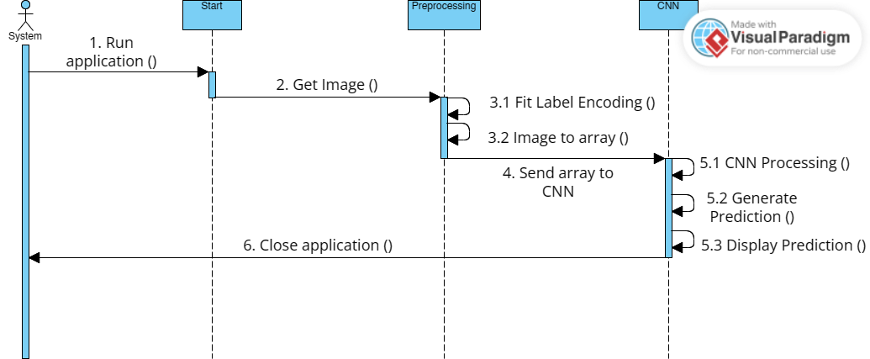
Sequence Diagram - Image

Slide 14
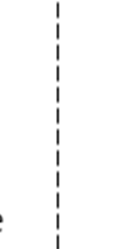

Conclusion
In conclusion, the Disaster Detection project represents a significant advancement in disaster monitoring and response, greatly aided by the integration of various UML diagrams. These visual representations, including use case diagrams, sequence diagrams, process flows, and state charts, provided deeper insights into the project's architecture and functionality. Through the integration of state-of-the-art models like Convolutional Neural Networks (CNNs), the system adeptly overcomes limitations of traditional approaches.

Slide 15

THANK YOU!

